Slide 1


Project 1
Title ???
Jasmine, Neda, Anthony, Benjy

Slide 2
Outline
Introduction/Objective
Tasks
Cleaning data sets
Merging data sets
Visualizing the data
Statistical analysis
Results and discussion
Conclusions

Slide 3
Objective
Investigation of the relationships between the college graduation rate, family income and poverty rate in the state of Ohio

Slide 4
Sources of Data
U.S. Bureau of labor Statistics
Ohio department of education
https://www.indexmundi.com
???
Five data sets were obtained, merged and cleaned in the Jupyter notebook with Pandas libraray

Slide 5
Initial thoughts on data
We did not expect to be such a large correlation between median income and number of degrees earned.
No expected correlation between poverty rate and degrees earned.
As degrees earned rises, the unemployment rate goes down.

Slide 6
Sample Data Sets

Slide 7
Sample Data Sets

Slide 8
Sample Data Sets

Slide 9
Overview of the Summary Table

Slide 10
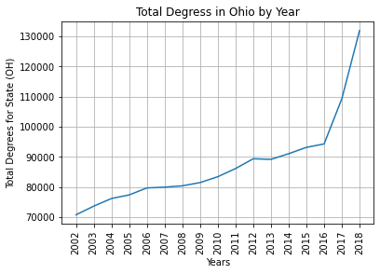

Slide 11
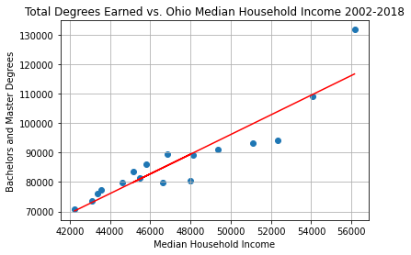
Plot x Overview

Slide 12
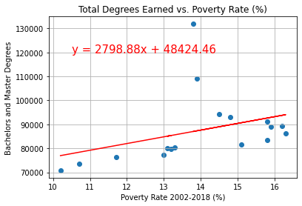
Plot x Overview

Slide 13
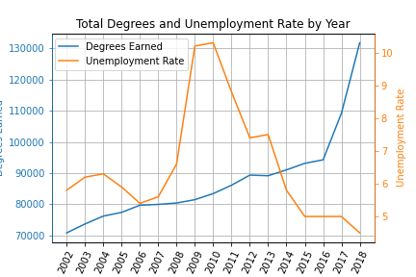
Plot x Overview

Slide 14
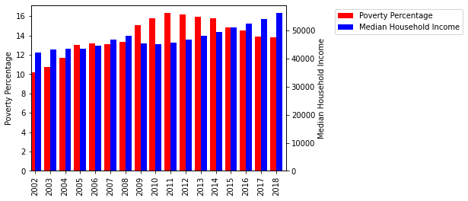
Plot x Overview

Slide 15
Project Conlusion

Slide 17
Sample Data Sets

Slide 18
Sample Data Sets

Slide 21
Sample Data Sets

Slide 25

Thank you for your attention!

